Slide 1
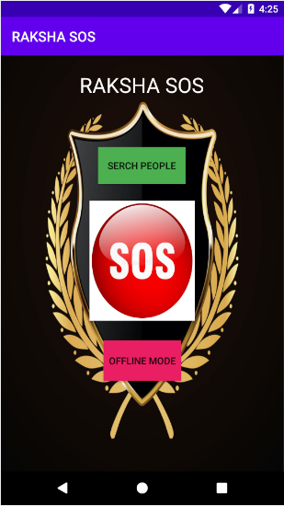
Raksha SOS
Why take a risky situation better avoid it before it happens.
So,this app basically checks and provides safety and security to the user. It has many features which are very much user-friendly.
User can check the authenticity of other user with whom they wants to get accompanied by checking the verification blue tick on their profile.
Using this app the user can connect to other users and ask for them for their company and if they loved their company, they would give them a 5star rating.
User can disconnect the other accompanied user if they finds something suspicious about them.

Slide 2
APP
Find People near you
Offline mode
SOS
Using this app, the users can find other users in their vicinity connect to them and ask for their company.
Why to get in a risky situation when you can avoid it before it happens.The SOS message will be sent to all the contacts in the contact list.
There are instances where none of the possible situation would work in offline mode.So we have introduced a distress alarm which will alert the people going /
living nearby
User can check the authenticity of the other users to find company by checking blue-tick on their profile and reviews of the other person they are gonna with
A real time location will be shared with the user along with satellite view to hide themselves.

Slide 3
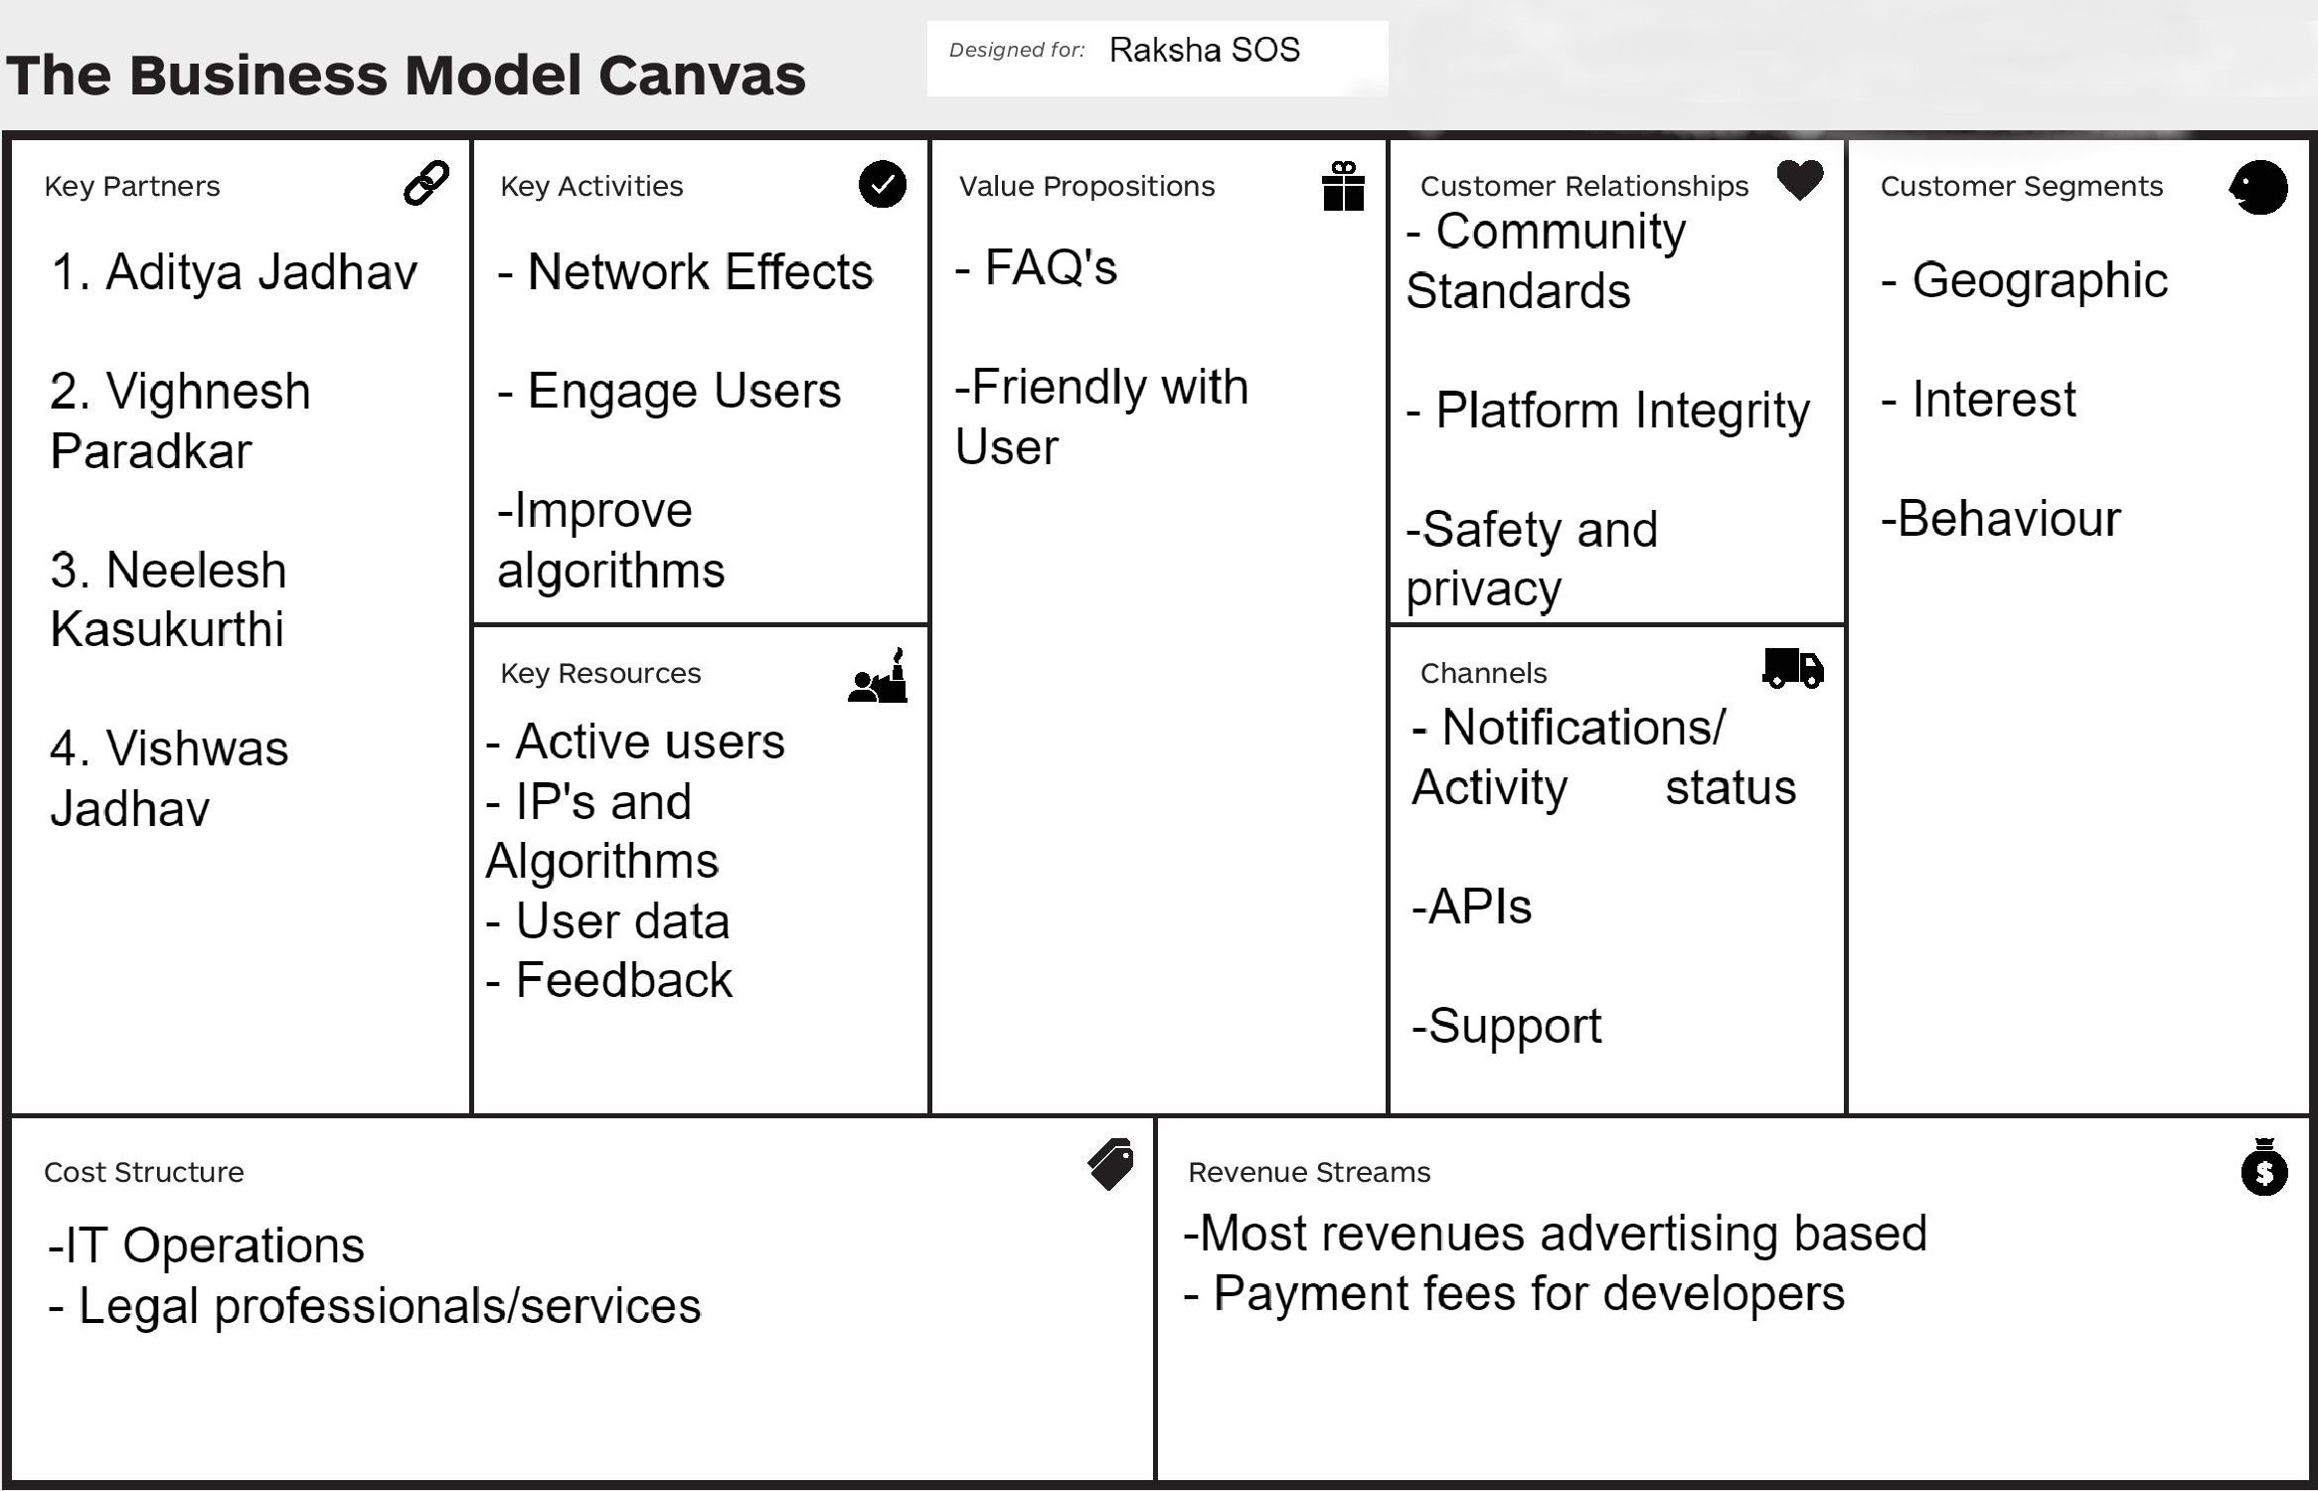
Business Model Canvas

Slide 4
Pros
Cons
The Pros of the App
The cons of the App
Avoiding danger situations before by travelling in a group.
User rating system {i.e. the more good review the good rating and more reliable person}
App can be used in offline mode also by distress alarm.
Misuse of verified accounts.
No SOS Feature available in offline mode.
No assistance in offline mode.
The Volume of Distress Alarm depends on the mobile volume.

